Slide 1
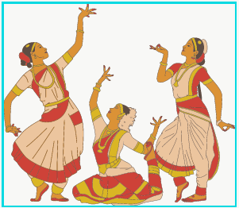
A Systematic Approach for Bharatanatyam Hand Mudra Classification by Employing CNN
SUBMITTED BY:
NAME: ANAJALI CHAVAN
USN: 3VY22MC017
UNDER THE GUIDANCE OF:
Dr. SWAROOPA SHASTRI
ASST. PROFESSOR
MCA DEPARTMENT.
VTU, KALABURAGI

Slide 2
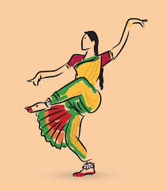
Content
Introduction
Objectives
Existing System
Proposed System
Implementation
Screenshots
Conclusion

Slide 3
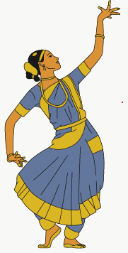
1. INTRODUCTION A distinctive feature of Bharatanatyam Dance is the use of expressive Hastas. Hastas refers to a variety of hand symbols that a dancer can use. They can be classified as Asamyuta Hastas (Single hand gestures) and Samyuta Hastas (Double hand gestures). There exist 28 Asamyuta Hastas and 24 Samyuta Hastas.
PROBLEM STATEMENT :
Recognition of ten hand gestures(five samyuta and five asamyuta hastas) frequently used by a Bharatanatyam dancer.

Slide 4
2. OBJECTIVES
To develop a model that automatically identify and classify different hand mudra’s
Image processing techniques apply to identify and classify different hand mudras used in Bharatanatyam based on input images.

Slide 5
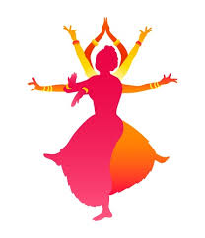
3. EXISTING SYSTEM
There has been a lot’s of research being carried out in the field of image recognition and hand mudra recognition. They have used the traditional image processing and machine learning techniques. In Bharatanatyam hand mudras, previously the researchers are mainly focused on the asamyuta hasta classification and some are focused on samyuta hasta classification and the performance of that model are not so satisfactory. The dataset are collected from YouTube, Google, and other websites and so on. Those models consume lots of time to train the model. And they are costly.

Slide 6
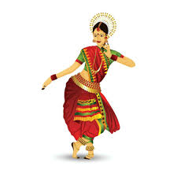
4. PROPOSED SYSTEM
In hand mudra recognition I have used the Convolutional neural network which is specially used for image classification and object detection. In Bharatanatyam hand mudras I have focused on both asamyuta and samyuta hasta which are most frequently used in Bharatanatyam dance. The performance of model is increased compare to previous models and it is satisfactory. The custom dataset is used. It is cost effective and easy to learn.

Slide 7
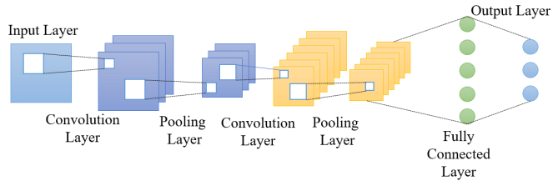
METHODOLOGY USED
Convolutional Neural Networks (CNNs) are a class of deep learning algorithms designed to process and analyze visual data. They have been highly successful in image recognition, classification, and various other tasks that involve spatial hierarchies in data.
CONVOLUTIONAL NEURAL NETWORK (CNN)
.
CNN ARCHITECTURE

Slide 8
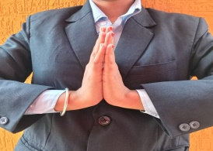
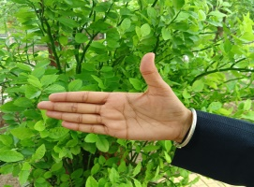
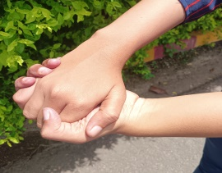
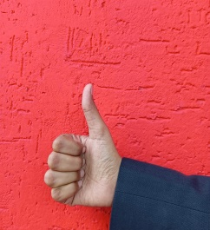
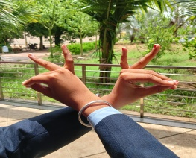
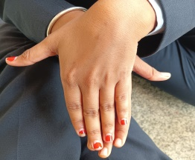
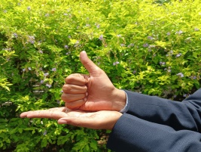
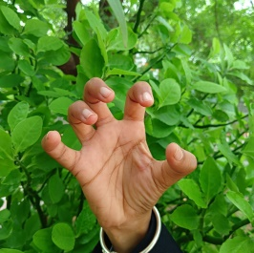
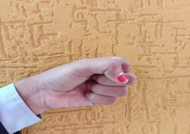
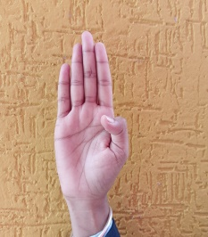
Custom Dataset
Anjali Ardhachandra
Samputa
Shikara
Katskaavardanm
Matsya
Shivalinga
Vyagraha
In this dataset
classes – 10
Total image – 13,551
This dataset is splinted into training(10,844) and validation(2,707).
Mushti
Pataka

Slide 9
Schematic view of mudra recognition process
CAPTURE IMAGE/BROWSE IMAGE
PRE-PROCESS
SEGMENTAION
FEATURE EXTRACTION
CLASSIFICATION

Slide 10
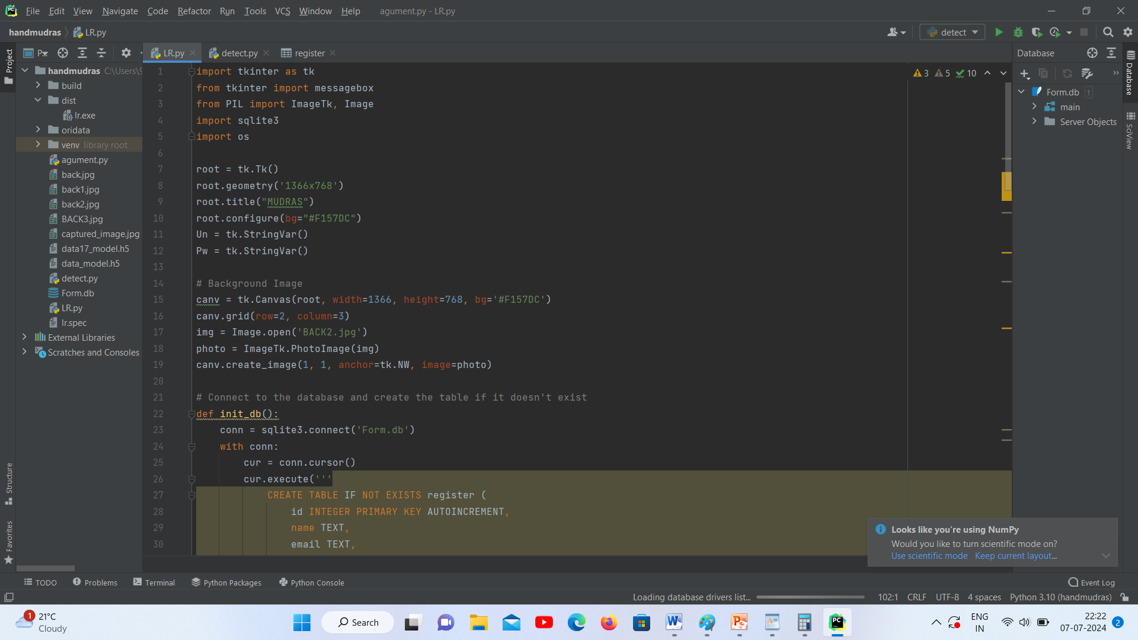
5. IMPLEMENTATION

Slide 11
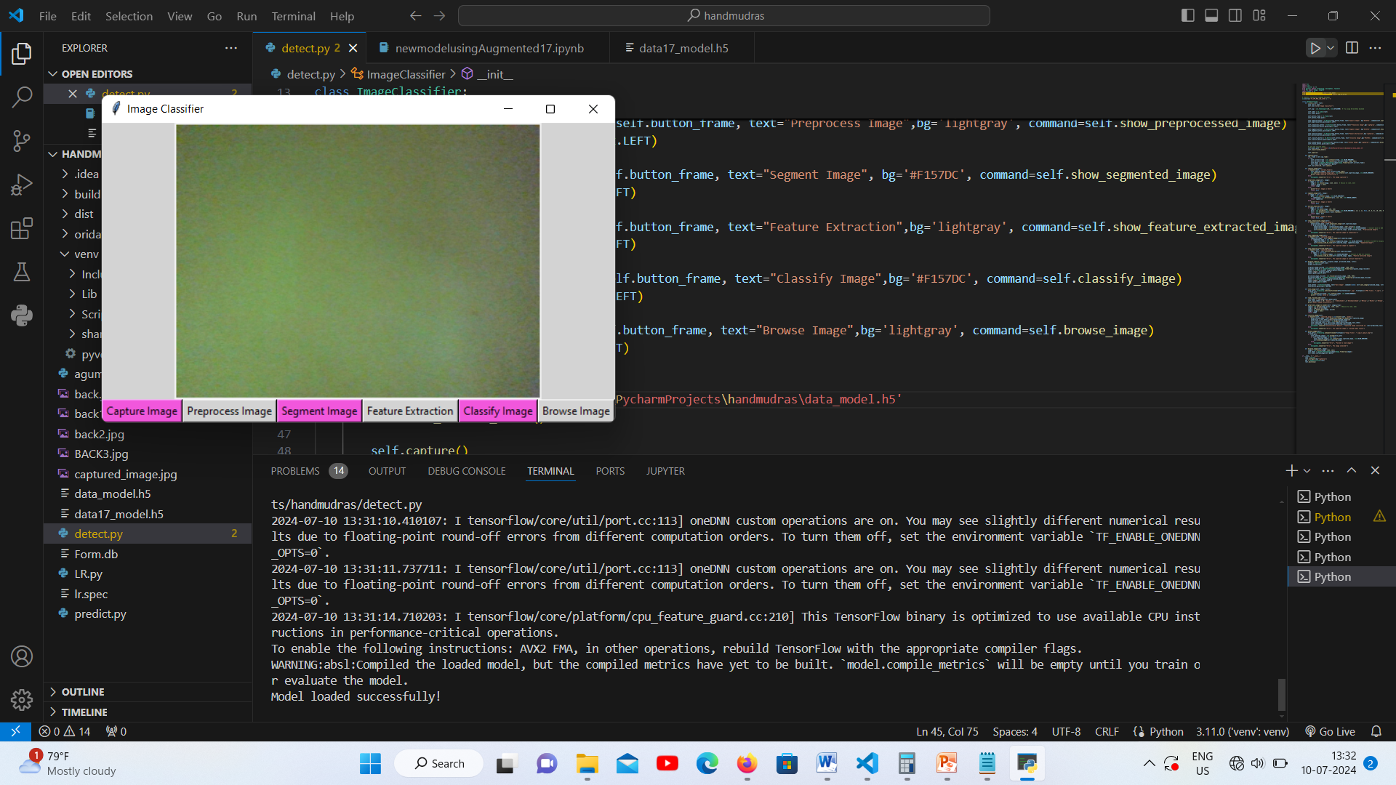
6. SCREENSHOTS
HOME PAGE

Slide 12
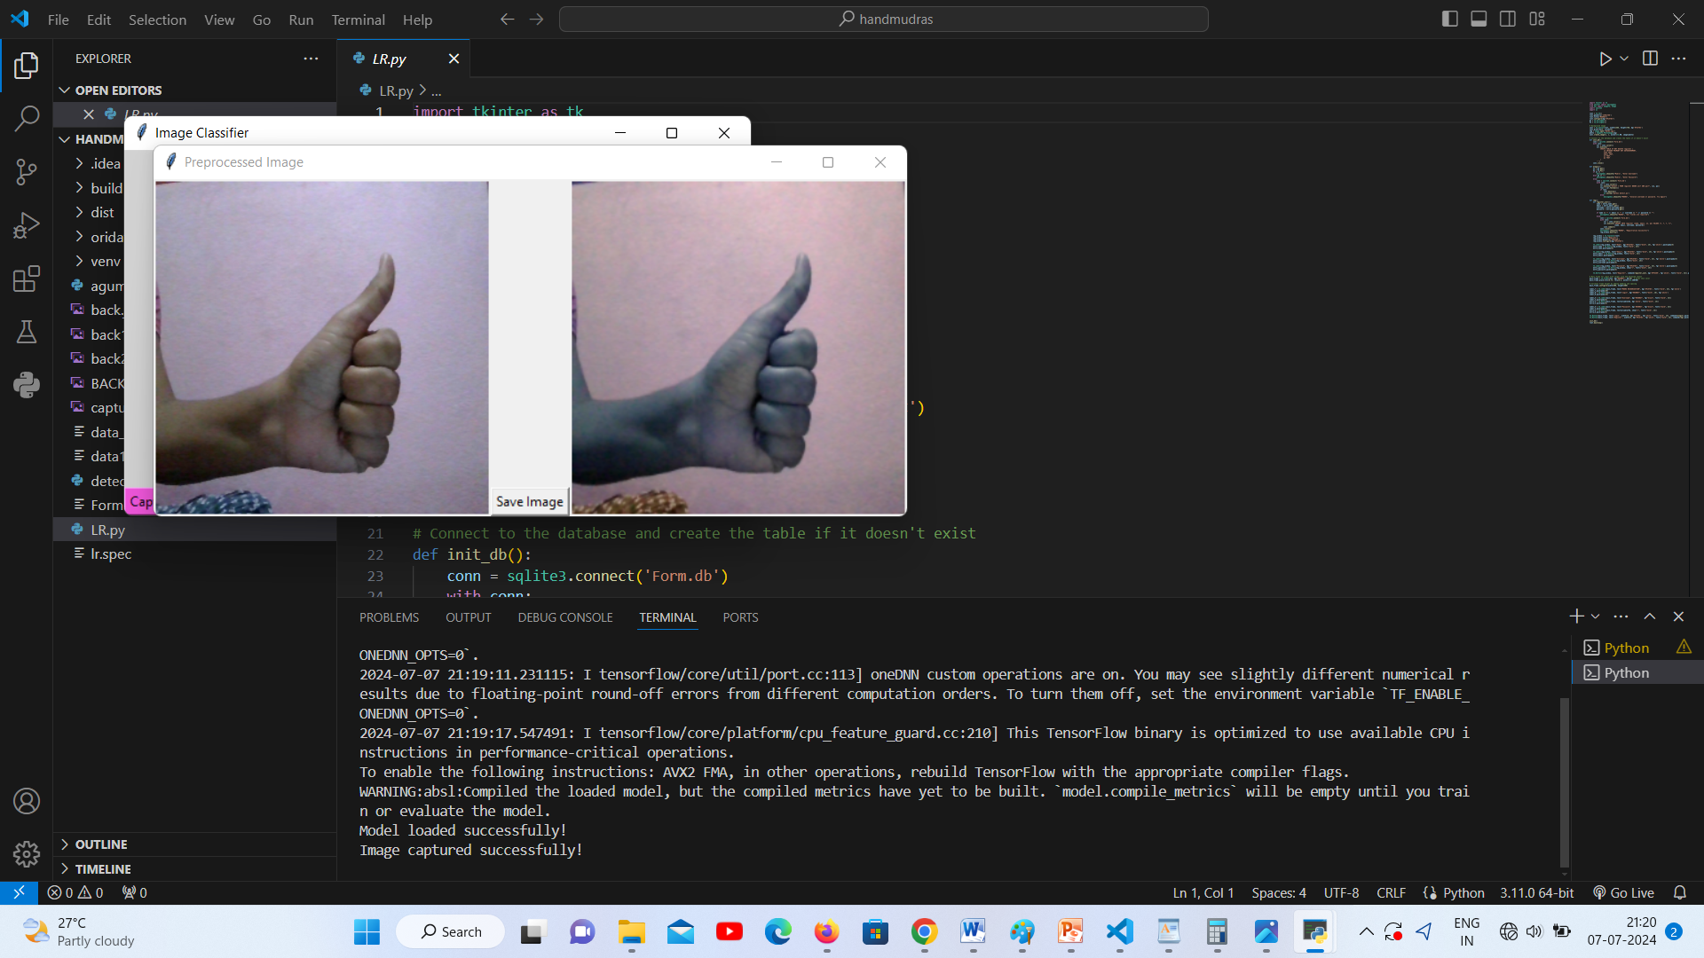
PREPROCESSING IMAGE

Slide 13
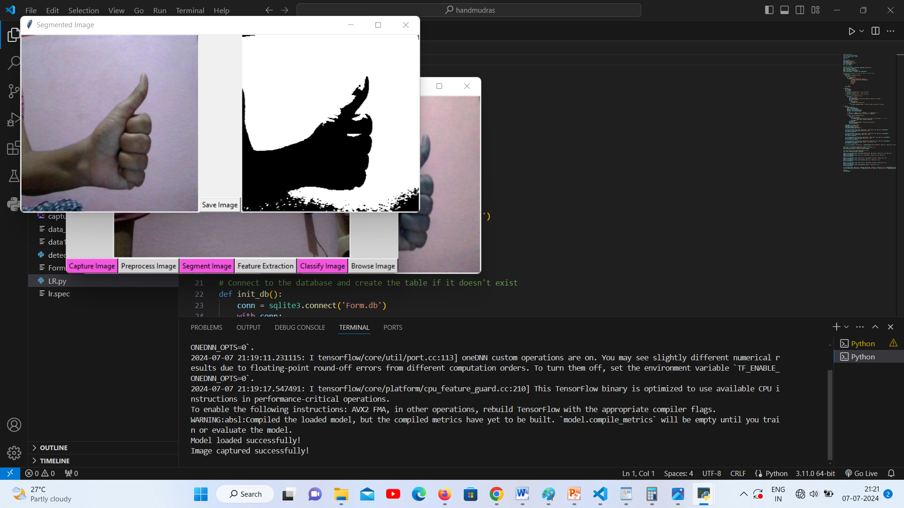
SEGMENT IMAGE

Slide 14
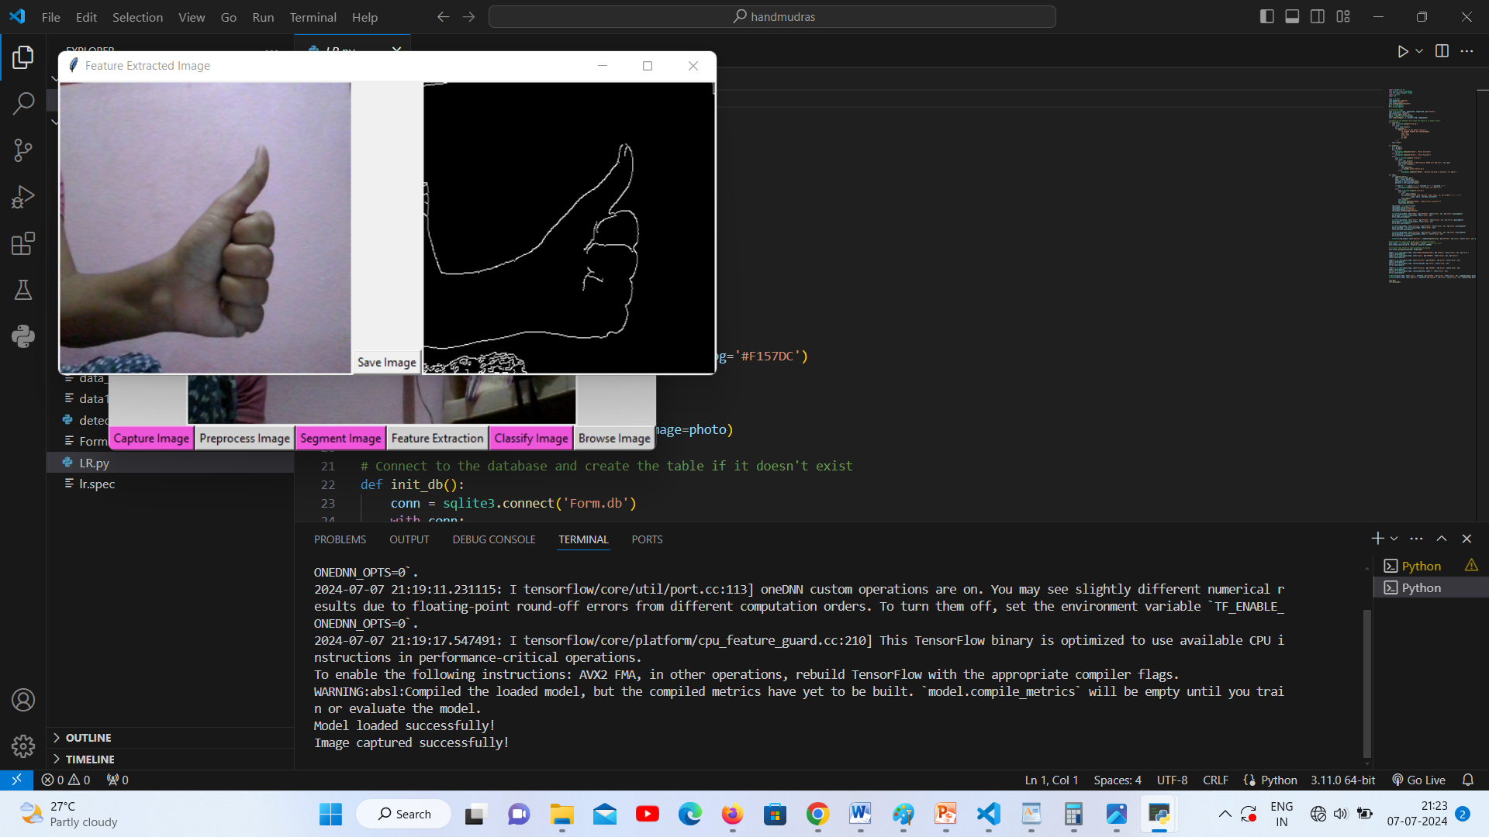
FEATURE EXTRACTION

Slide 15
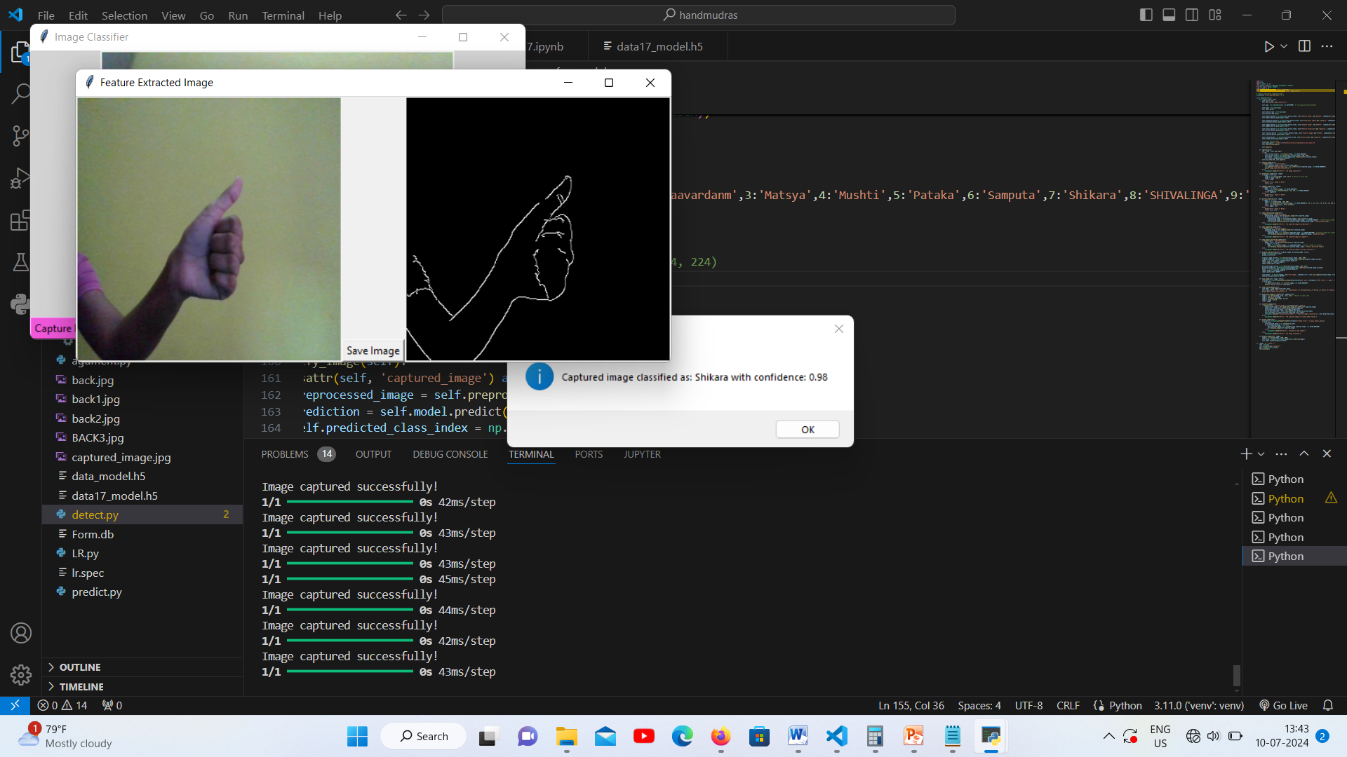
CLASSIFY IMAGE

Slide 16
7. CONCLUSION
A Convolutional neural network is a class of deep learning architectures which is used for automatically learn the features from the input. They are used in different domain such as computer vision, transfer learning, image classification, and so on. The dataset is augmented; the augmented dataset is trained using Convolutional neural networks algorithm. The high classification accuracy obtained is 99.34% using the Convolutional neural networks. further the classification of Bharatanatyam hand mudras using Convolutional Neural Networks (CNNs) can be enhanced by exploring alternative methodologies to improve model performance. Alternatively, sticking with this methodology can yield better results than the current system. Additionally, there is potential to expand classification to include other hand mudras and explore various forms of Bharatanatyam mudras.

Slide 17


